Slide 1


Morphology and Word Formation in Natural Languages
DSA0302 – Natural Language Processing
Assessment Tool 2 – CO1
Guided By: Presented By:
Dr. T. Devi Mohammed Rayan Shaikh (192424059)

Slide 2
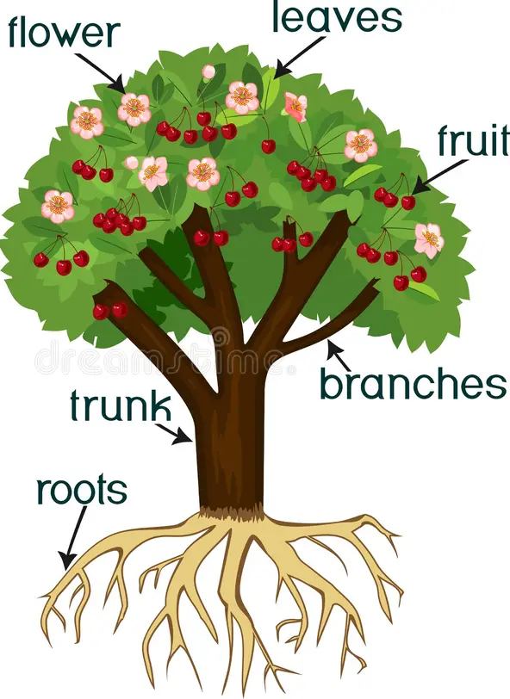
INTRODUCTION
What is Morphology?
Morphology is the study of how words are formed. It explains how smaller meaningful units called morphemes combine to create words. Understanding morphology helps computers process language more accurately in Natural Language Processing.

Slide 3
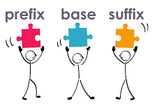
Morphemes and Word Formation
What are Morphemes?
A morpheme is the smallest meaningful unit of a word. Words may consist of a single morpheme or multiple morphemes combined together.
Types of Morphemes
1. Free Morphemes
Can stand alone as independent words.
They carry meaning without requiring any additional element.
Examples: book, tree, run, happy, school
2. Bound Morphemes
Cannot stand alone and must be attached to a free morpheme.
They modify the meaning or grammatical form of a word.
Examples: un-, re-, -ed, -ing, -s

Slide 4
Word Formation
Word Formation Processes
Prefixation: Adding a prefix before the root word. happy → unhappy
Suffixation: Adding a suffix after the root word. teach → teacher
Compounding: Combining two independent words. black + board → blackboard
Inflection: Changing a word to express grammatical information such as tense, number, or degree. walk → walked, book → books
Derivation: Forming a new word with a different meaning or part of speech. beauty → beautiful, kind → kindness

Slide 5

Morphological Analysis
What is Morphological Analysis?
Morphological analysis is the process of breaking words into their basic morphemes to identify the root word and understand its grammatical structure. It enables NLP systems to recognize different forms of the same word and interpret their meanings correctly.
Word | Root Word | Morphological Information
Playing | Play | Verb + Present Participle (-ing)
Walked | Walk | Verb + Past Tense (-ed)

Slide 6

Morphological Importance
Importance of Morphology in NLP
Morphological analysis plays a vital role in improving the accuracy and efficiency of NLP applications by helping computers understand word structures and relationships.
Key Applications
Tokenization: Splits text into meaningful words or tokens.
Stemming: Removes prefixes or suffixes to obtain the root form.
Part-of-Speech (POS) Tagging: Identifies the grammatical role of each word.
Text Classification & Sentiment Analysis: Enhances the understanding of text meaning and emotions.

Slide 7
Code
Output:
Morphological Analysis
Original Word : playing
Stem : play
Lemma : playing
------------------------------------------
Original Word : walked
Stem : walk
Lemma : walked
------------------------------------------
Original Word : teachers
Stem : teacher
Lemma : teacher
------------------------------------------
Original Word : unhappiness
Stem : unhappi
Lemma : unhappiness
------------------------------------------
Original Word : running
Stem : run
Lemma : running
------------------------------------------
Original Word : studies
Stem : studi
Lemma : study
------------------------------------------
import nltk
from nltk.stem import PorterStemmer, WordNetLemmatizer
nltk.download('wordnet')
nltk.download('omw-1.4')
# Create objects
stemmer = PorterStemmer()
lemmatizer = WordNetLemmatizer()
# Sample words
words = ["cooking", "walked", "teachers", "unhappiness", "running", "reading"]
print("Morphological Analysis\n")
for word in words:
stem = stemmer.stem(word)
lemma = lemmatizer.lemmatize(word)
print(f"Original Word : {word}")
print(f"Stem : {stem}")
print(f"Lemma : {lemma}")
print("-" * 30)

Slide 8

CONCLUSION
Morphology is an important component of Natural Language Processing because it helps computers understand how words are formed and related.
By analyzing morphemes and word formation, NLP systems can process text more accurately, leading to better performance in applications such as translation, search engines, speech recognition, and virtual assistants.

Slide 9
THANK YOU!

